Slide 1
Regulation of Gene Expression
Chapter 6.4
McGraw-Hill Ryerson
Biology 12 (2011)

Slide 2
Regulation of Gene Expression
Gene Regulation: refers to control of the level of gene expression
It makes sense to conserve energy and material and not synthesize proteins when not needed
Constitutive Genes: gene constantly expressed
Some genes are always active and expressed essentially at constant levels → these proteins are needed for survival of the cell

Slide 3
Regulation of Gene Expression in Prokaryotes
Operons: a cluster of genes grouped together under the control of one promoter
Remember that a promoter is where RNA polymerase binds to DNA to begin transcription
Occurs in prokaryotic genomes
Genes that are involved in the same metabolic pathway are often found in the same operon
All under the control of the same promoter region
Thus these genes are transcribed all together into one continuous mRNA strand: polycistronic mRNA
Proteins are then synthesized from that mRNA

Slide 4
Lac operon
E.coli can use lactose to grow so when surrounded by lactose, will turn on machinery to make lactose enzymes
Lac operon is responsible for coding enzymes to break down lactose
Operator: sequence in DNA to which a repressor protein binds
Repressor: a protein that binds to a particular DNA sequence to regulate transcription;
Inhibits transcription of gene(s)

Slide 5
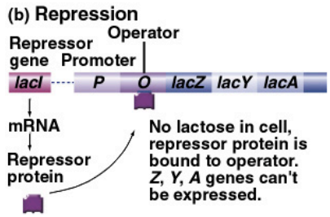
Lac operon
When lactose is absent: lac repressor binds to operator
Prevents RNA polymerase from binding to promoter thus transcription cannot occur = no enzyme

Slide 6
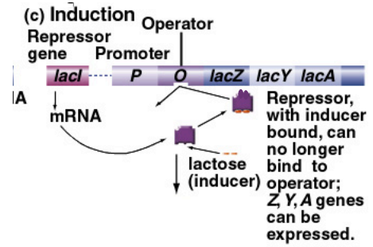
Lac operon
When lactose is present: allolactose is produced which binds to the repressor
Repressor can no longer bind to operator
RNA polymerase is now able to bind to promoter so transcription can occur = enzyme production to break down lactose

Slide 7
Lac operon
Lac operon is considered an inducible operon
i.e. transcription is induced when lactose is present

Slide 8
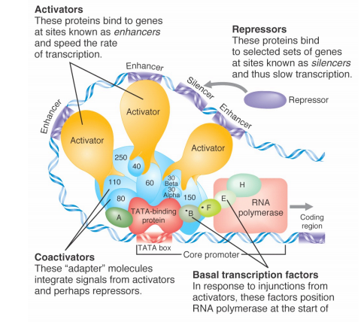
Regulation of Gene Expression in Eukaryotes
Transcription Factors: proteins required to interact with RNA polymerase to initiate transcription
Enhancers: sequences of DNA that proteins bind to so that transcription is enhanced
RNA interference: miRNA (microRNA) and siRNA (small interefering RNA) inhibits gene expression by degrading mRNA or inhibiting translation

Slide 9
Homework
Pg 272 #3, 4, 5

