Slide 1
DNA Repair
Chapter 5.2
McGraw-Hill Ryerson
Biology 12 (2011)

Slide 2
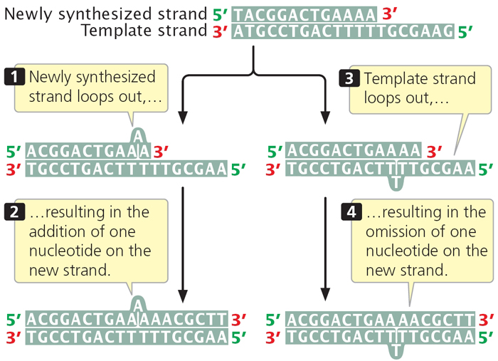
Correcting errors during DNA replication
Errors can arise from
Mispairing a new nucleotide to a nucleotide on the template strand
E.g. pairing a T with a C accidentally
Strand slippage: accidental additions or omissions of nucleotide

Slide 3
Correcting errors during DNA replication
DNA Polymerases involved with correcting errors
DNA polymerase I and II proofread the new strand
When incorrect nucleotide is present, the 3’ hydroxyl end is in the wrong position
DNA polymerase excise the incorrect base and add the correct base to the new strand (using the parent strand as a template)
Mismatch repair
Mispairing of bases causes deformities in new synthesized molecule
Deformities recognized by group of enzymes that bind to the DNA and specifically remove the incorrect base from the daughter strand
Errors that still remain after DNA polymerase proofreading or mismatch repair are then considered mutations in the genome once cell division has occured

