Slide 1
DNA Structure and Organization in the Cell
Chapter 5.1
McGraw-Hill Ryerson
Biology 12 (2011)

Slide 2
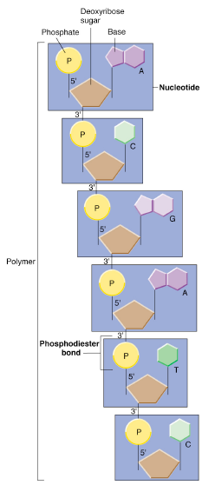
DNA – Material of Heredity
The discovery that DNA was a chromosomal constituent did not establish that it had anything to do with genes. Many scientists at the time pointed to proteins as the likely genetic material.

Slide 3
DNA – Material of Heredity
Bacteria carry their genetic material
as a single circular chromosome,
without it being enclosed by a nuclear
membrane (prokaryotes)
1923 – Frederick Griffith performed studies with Streptococcus pneumoniae
Two forms
S-Strain which is wild-type and highly pathogenic
R-Strain which was non-pathogenic
He concluded that mice died after being given a mixture of heat-killed S-strain and living R-strain bacteria…

Slide 4
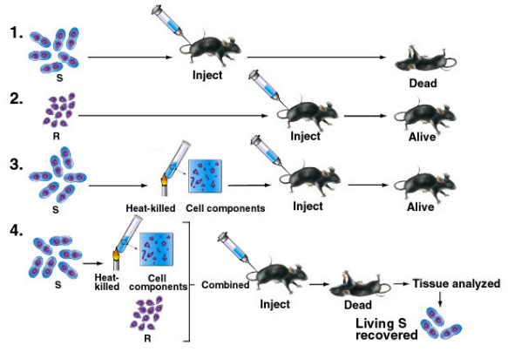

Slide 5
DNA – Transforming Principle
By 1929 two other labs had repeated the results of Griffith
1931 – Lab of Oswald Avery was able to achieve transformation without an animal host, simply by growing R-form bacteria in medium in the presence of components from dead S-forms
i.e. they kinda made living S-form from scratch
Transformation: process by which an organism takes up genetic material from the environment under certain conditions

Slide 6
DNA – Transforming Principle
1944 Avery and co.
Prepared various purified and semi-purified components from the mixture and tested to see if they could transform R form bacteria. The only one that could was determined to be DNA.
Further tested this preparation by subjecting it to various chemicals………

Slide 7
DNA – Transforming Principle
Avery and his team suggested that genes were made up of DNA
But people in the science community still thought complex proteins were the holders of genes and genetic material

Slide 8
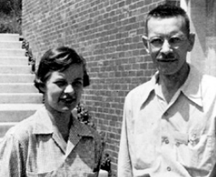
Evidence that genes are made of DNA
1952 – Experiments of Chase and Hershey, infecting bacterial cells with bacteriophages
Finally provided evidence that genes are made up of DNA

Slide 9
Evidence that genes are made of DNA
T2 bacteriophages are very small, and are composed of approximately equal weights of protein and DNA.
They depend on the host cell machinery for their replication.
What substance directs the production of new phage particles, DNA or protein? Chase and Hershey were about to find out

Slide 10
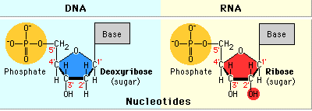
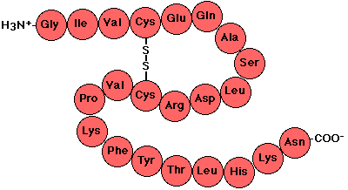
Evidence that genes are made of DNA
Remember what makes up a nucleotide in DNA?
Remember what disulfide bonds in proteins?
The sulfur come from these amino acids:

Slide 11
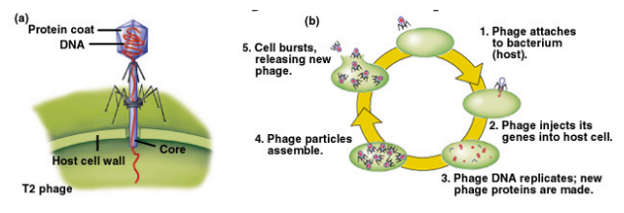
Evidence that genes are made of DNA
They knew what phages did too…

Slide 12
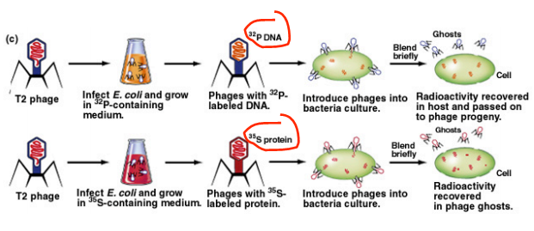
Evidence that genes are made of DNA
Chase and Hershey cleverly used those facts to their advantage
They proved that DNA was indeed the holder of genes and genetic material

Slide 13
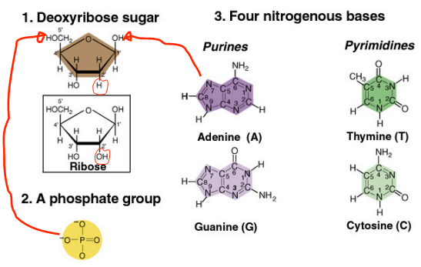
Chemical constituents of DNA

Slide 14
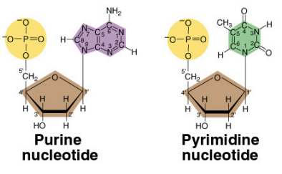
Chemical constituents of DNA

Slide 15
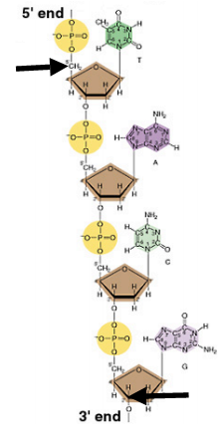
Chemical constituents of DNA
Nucleotides are linked in a chain by phosphodiester bonds

Slide 16
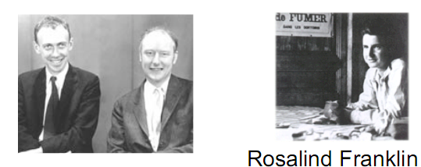
Chemical constituents of DNA
First proposed by James Watson and Francis Crick in a 1953 paper
Based on both X-ray diffraction data, and studies of the chemical composition of DNA, including the finding that the ratio of both A:T and G:C is 1:1

Slide 17
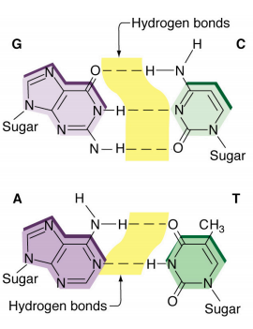
Chemical constituents of DNA

Slide 18
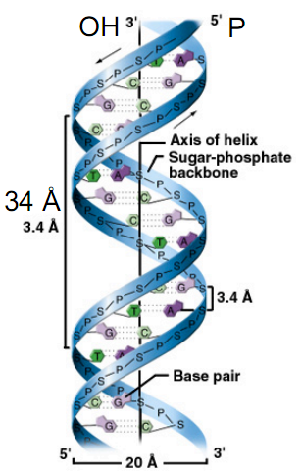
Structure of DNA
Anti-parallel strands held together by hydrogen bonding between the base pairs.
One complete turn every 34Å
Ratio of A to T is always 1:1 as is the ratio of G to C

Slide 19
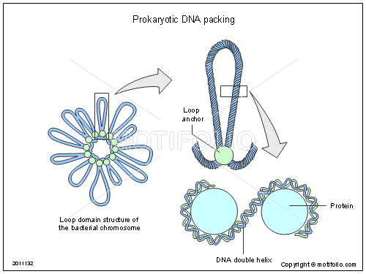
Structure of DNA
Prokaryotic DNA
Circular
Regulatory sequences: sequence of DNA that regulates gene activity
Can carry many small plasmids
Can be copied, transferred, or incorporated into cell’s chromosomal DNA
Thus hereditery information on plasmid can be transferred from cell to cell
Supercoiled controlled by topoisomerase I and II

Slide 20
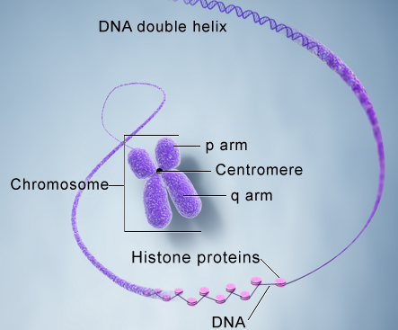
Structure of DNA
Eukaryotic DNA
Double helix
Wraps itself around histones as it’s own superpacking mechanism
Wrapping allows DNA to be packed into condensed chromosome form
Chromatin: non-condensed form of genetic material
Stays in this form for most of cell cycle (interphase)

Slide 21
Homework
Pg 218
#1-6, 9, 14

