Slide 1
Transport across cell membranes
Chapter 2.2
McGraw-Hill Ryerson
Biology 12 (2011)

Slide 2
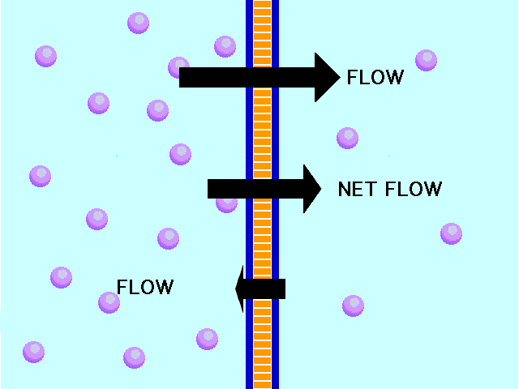
Concentration gradient
Concentration gradient: difference in concentration between one side of a membrane and the other
Ions and molecules like to move from high to low
Diffusion: the net movement of ions or molecules from an area of higher concentration to area of lower concentration

Slide 3
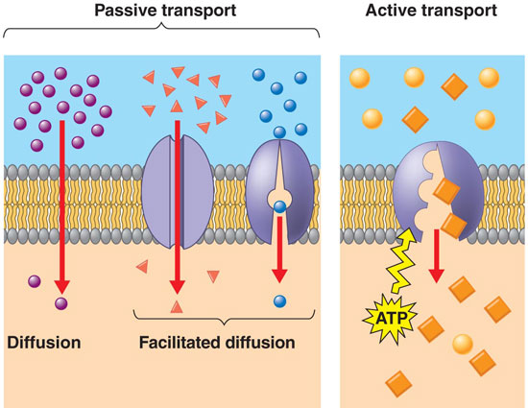
Transport across a membrane
Different types of transport across membranes exist:
Passive transport by diffusion
Passive transport by osmosis
Passive transport by facilitated diffusion
Active Transport

Slide 4
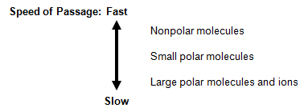
Passive Transport by Diffusion
Diffusion across a membrane happens naturally by diffusion
Factors that affect rate of diffusion:
Molecule size: larger molecules = slower rate of diffusion
Molecule polarity: polar molecules = slower rate of diffusion
Molecule or ion charge: charged molecules and ions cannot freely diffuse across a cell membrane

Slide 5
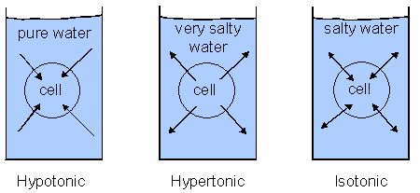
Passive Transport by Osmosis
Osmosis: diffusion of water across a selectively permeable membrane
Cells must maintain enough water for cellular processes
Osmotic pressure: force of osmosis
Hypotonic: solution with the higher concentration versus the cell
Isotonic: solution with equal osmotic concentration to inner cell
Hypertonic: solution with the lower concentration versus the cell
What happens to the cell in each?

Slide 6
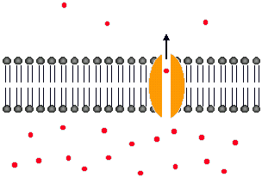
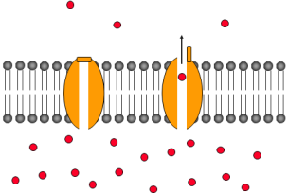
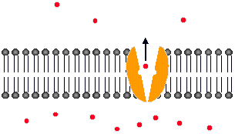
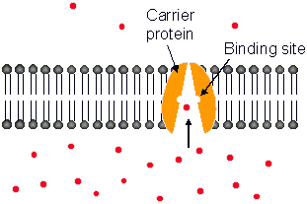
Passive Transport by Facilitated Diffusion
Large molecules needed by cell require assistant to cross membrane
Proteins can assist transport through facilitated diffusion
Channel proteins: passage that allows specific molecules to pass through
Gated Channels: regulate passage of particles by opening or closing the channel
Carrier Proteins: binds particles, changes shape, and then releases them on the other side
All these do not require any additional energy since diffusion does all the work

Slide 7
Active Transport
Transport of a solute across a membrane against its concentration gradient
Requires energy (usually ATP)
2 types of active transport
Primary Active Transport: uses ATP directly to move molecules or ions across a membrane
Secondary Active Transport: uses an electrochemical gradient as energy, which is built using other transport proteins that use ATP
(thus uses ATP indirectly)

Slide 8
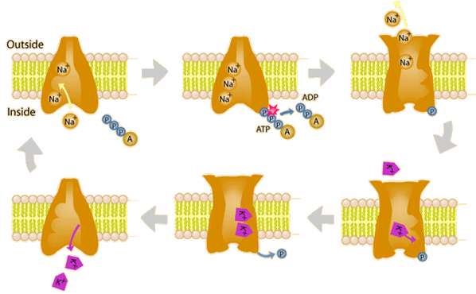
Active Transport
Primary Active Transport
Sodium-Potassium Pump is one well-studied example

Slide 9
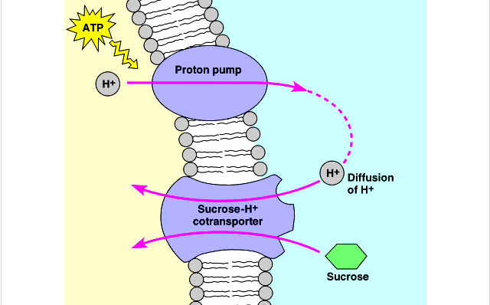
Active Transport
Secondary Active Transport
Proton/Sucrose symporter is an example

Slide 10
Membrane-Assisted Transport
Sometimes molecules are too big to pass through proteins
Cells, instead, form vesicles around material using their membrane
Requires energy
Two forms of membrane transport:
Endocytosis
Exocytosis

Slide 11
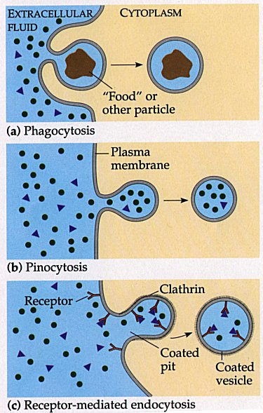
Endocytosis
Process by which a cell engulfs material to bring into the cell
2 major types
Phagocytosis
Engulfing large particles (“cell eating”)
Pinocytosis
Engulfing macromolecules and liquids (“cell drinking”)

Slide 12
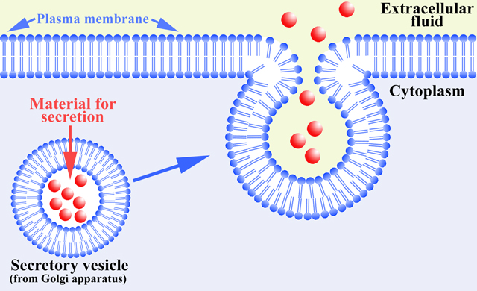
Exocytosis
Process by which a cell engulfs material to release out of the cell
Vesicle that contains the products fuse with cell membrane and empty contents into extracellular environment

Slide 13
Homework
Please look at pg 79 and use Table 2.2 as a reference to see what we learned about transport
Pg. 81 #2, 3, 4, 6, 7, 9, 12

