Slide 1
Structures and Processes of the Nervous System
Chapter 8.4
McGraw-Hill Ryerson
Biology 12 (2011)

Slide 2
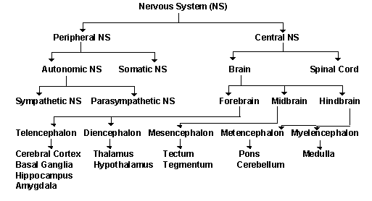

Slide 3
All nerves within the PNS contain a thin membrane called the neurilemma
Neurilemma promotes the regeneration of damaged axons
Grey Matter
Nerves in the brain and spinal cord (CNS)that lack myelin and neurilemma
White matter
Nerves in the brain and spinal cord (CNS) that contain myelin and neurilemma
Notes:
http://www.youtube.com/watch?v=AjxJabpjDGo

Slide 4
Peripheral Nervous System (PNS)
All parts of the nervous system lying outside the brain and spinal cord.
The sensory and motor neurons that connect to the CNS
Function = to carry info between organs of the body and the CNS
Humans have
12 paris of cranial nerves (sensory/motor/mixed) which control the head, face, neck, shoulders
Except VAGUS nerve – controls internal organs
31 pairs of spinal nerves (mixed) which take impulses to and from the spinal cord

Slide 6
PNS Somatic & Autonomic Nerves
Somatic nerves control skeletal muscle, bones, skin that a person can control
Sensory neurons which relay info about environment to CNS
Motor neurons which initiate appropriate response
Autonomic nerves control the muscles of the glands and internal organs which we can’t control
Sympathetic & parasympathetic components
Reflex Arc

Slide 7
“FLIGHT OR FIGHT RESPONSE”
Sympathetic component prepares body for stress [neurotransmitter used=norepinephrine]
Diverts blood from internal organs to skeletal muscles, heart & brain
Parasympathetic brings things back to normal [neurotransmitter used=acetylcholine]
Work in conjunction/opposition to each other
Ex. “on” / “off” switches

Slide 8
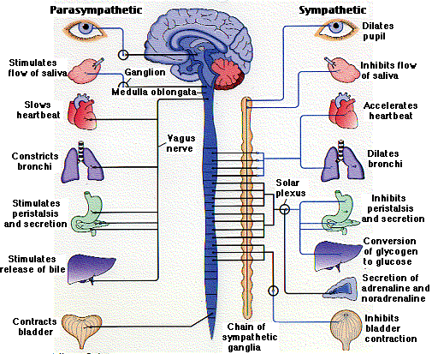

Slide 9
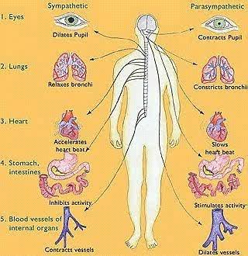

Slide 10
You come across a bear on your walk to school…what happens?
Sympathetic nervous system does what?
Increases heart rate
Increases breathing rate
Dilates bronchioles
Dilates pupils
Inhibits digestion

Slide 11
ADRENALIN (epinephrine)
Sympathetic nervous system also stimulates secretion of epinephrine and nor-epinephrine from the medulla of the adrenal glands
Prepares body for “flight or fight” response
“Epi-pen” given in allergic reactions as it relaxes constricted airways

Slide 12
PNS
Pg 372 has a very lovely table illustrating differences of sympathetic and parasympathetic

Slide 13
Homework
Pg 373 #4, 9, 11

