Slide 1
Translation
Chapter 6.3
McGraw-Hill Ryerson
Biology 12 (2011)

Slide 2
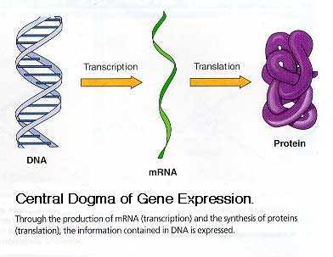

Slide 3
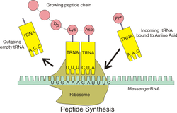
tRNAs
tRNAs: Transfer RNAs
Short, single-stranded RNA molecules
74 to 95 nucleotides long
tRNAs carry some modified bases
produced by chemical alterations of
the A,G,C and U nucleotides
Each tRNA carries one particular
amino acid

Slide 5
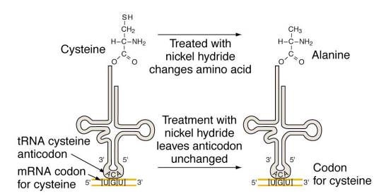
tRNAs
Base pairing between an mRNA codon and a
tRNA anticodon determines where an amino acid
becomes incorporated in a growing polypeptide
- not a function of the aa, but rather the tRNA

Slide 6
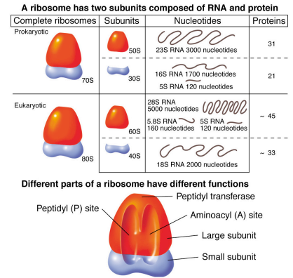
Ribosomes
Ribosomes:
Sites of protein synthesis
Complex structures composed of protein and RNA
Has attachment sites for mRNA and tRNA

Slide 7
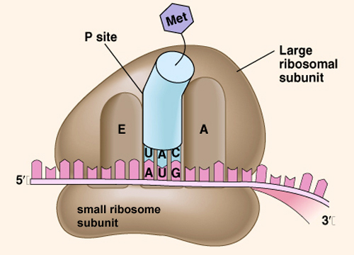
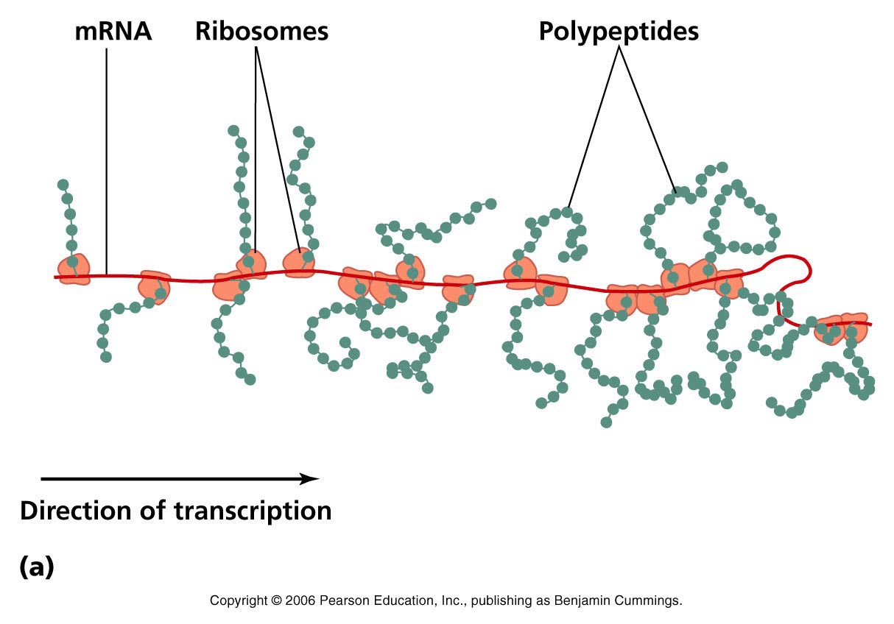

Slide 8
Molecular Events of Translation
Translation divided into 3 phases:
Initiation
Elongation
Termination

Slide 9
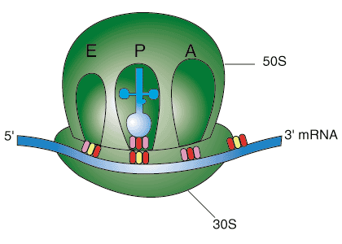
Initiation
Small ribosomal subunit binds to start codon: AUG
First tRNA that binds is initiator with its UAC anticodon
ribosome has 3 sites for tRNA attachment:
A site, P site, E site (amino acid, peptide, exit)
At initiation, initiator tRNA binds to P site.

Slide 10
Elongation
Once initator tRNA is bound to ribosome
A-site is occupied by tRNA with an anticodon that base pairs with the second mRNA codon and carries the second amino acid
Second amino acid peptide bonds with first amino acid
This continues for 3rd, 4th, 5th amino acid, etc…

Slide 11
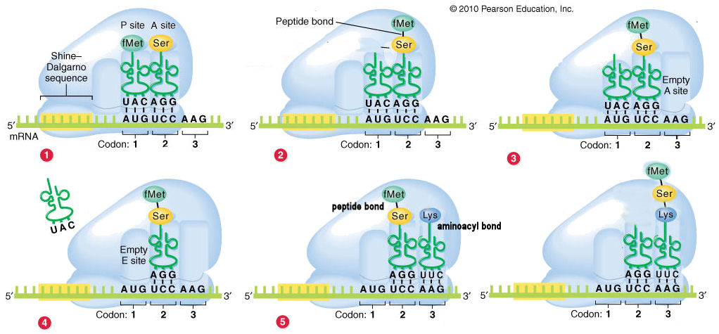
Elongation

Slide 12
Termination
Termination begins when stop codon on the mRNA is reached
Polypeptide and machinery are separated
Polypeptide is released by a release factor protein by cutting it from the last tRNA
Polypeptide eventually folds into its 3D shape to carry out its function

Slide 13
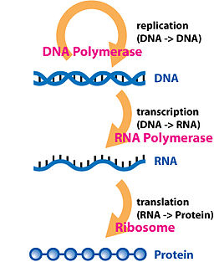
Review of Gene Expression
Refer to Figure 6.16 on pg 261 in your textbook

Slide 14
Mutations
Mutation: permanent change in nucleotide sequence of a cell’s DNA
Single-gene mutation: mutation that involves changes in the nucleotide sequence of one gene
Chromosomal mutation: mutation that involves changes in the chromosomes, and may involve many genes

Slide 15
Single-Gene Mutations
Point mutation: mutation where a single base pair gets substituted, inserted, or deleted
Remember that codons look at 3 nucleotides as a set in its reading frame
Insertions or deletions of a number of nucleotides not divisble by 3 can cause frameshift mutation
Frameshift mutation: results in a change in the reading frame

Slide 16
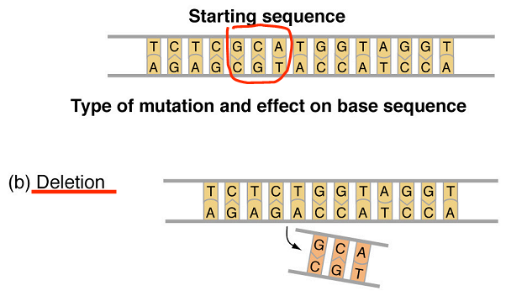
Single-Gene Mutations

Slide 17
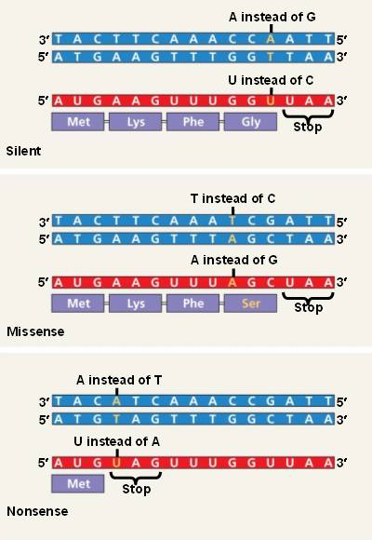
Single-Gene Mutations
Silent mutation: mutation that does not change the amino acid sequence of a protein
Remember that the genetic code is redundant (i.e. more than one codon can code for the same amino acid)
Missense mutation: mutation that results in an altered amino acid sequence of a protein
Can be harmful because the unintended change in amino acid can affect the protein’s ability to function
Nonsense mutation: mutation that shortens a protein by introducing a stop codon

Slide 18
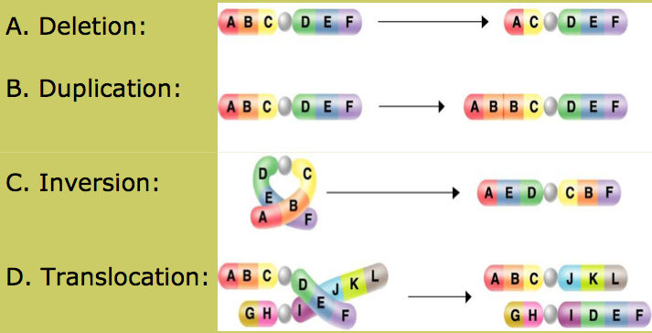
Chromosomal mutation
Pg. 263 Figure 6.19

Slide 19
Mutagens
Mutagens: substance or event that increases rate of changes to the DNA sequence of an organism’s genome
i.e. something that increases rate of mutation
e.g. X-rays, UV, nitrites, gasoline fumes, cigarette smoak

Slide 20
Homework
Pg. 266 #3, 7, 8, 10, 12, 13

