Slide 1
Transcription
Chapter 6.2
McGraw-Hill Ryerson
Biology 12 (2011)

Slide 2
Transcription
The process by which the polymerization
of ribonucleotides guided by complementary
base pairing produces an RNA transcript of
a gene
Nucleotides are added in the 5’-to-3’
direction
Uracil is incorporated in place of Thymine
in RNA (both pair with Adenine)

Slide 3
Transcription
RNA polymerase – the enzyme that catalyzes transcription;
Also unwinds and opens a section of the double helix
Promoters – DNA sequences near the beginnings of genes that signal RNA polymerase where to begin transcription
Terminators – Sequences in the RNA products that tell RNA polymerase where to stop (encoded by DNA)

Slide 4
Transcription
RNA polymerase binds to a promoter region on the DNA
Promoter region is a sequence of nucleotides indicating where RNA polymerase should bind to.
RNA polymerase works its way along DNA, synthesizing strand of mRNA that is complementary to template strand
Template strand is the strand that the mRNA is working off of (pairing A’s with U’s)
RNA Polymerase also works in the 5’ to 3’ direction until they reach a specific nucleotide sequence indicating it to stop
As soon as RNA polymerase starts to move along DNA, another RNA polymerase can bind to promoter and synthesize another mRNA → allows for simultaneous production of many mRNA

Slide 5
Things to remember
Sense strand (aka: coding strand) strand of DNA that runs from 5’ to 3’. Has same sequence as mRNA (except T’s and U’s).
Antisense strand (aka: template strand) strand of DNA that runs from 3’ to 5’. This is the strand RNA polymerase reads to transcribe.

Slide 6
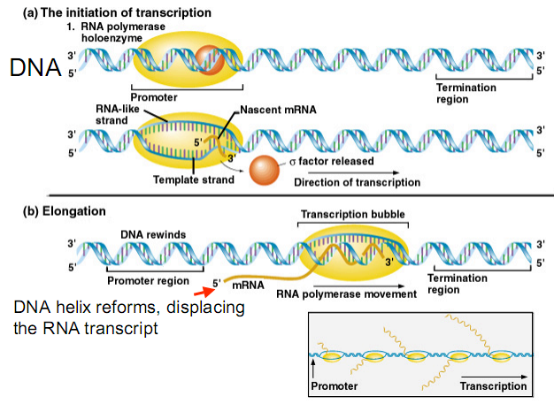
Transcription

Slide 7
mRNA modifications
Prokaryotes don’t possess a nucleus. Everything happens in their cell, thus mRNA can be used in protein synthesis as soon as it is made
Eukaryotes’ newly synthesized mRNA undergoes modifications before it leaves the nucleus and into the cytoplasm
Modifications convert precursor mRNA (pre-mRNA) to mature mRNA.

Slide 8
mRNA modifications
1. Addition of methylated cap at the 5’ end.
A special capping enzyme adds a guanidine triphosphate
in reverse orientation to the 5’ end after polymerization
of the transcript’s first few nucleotides. This G is NOT
encoded by the gene!
Methyl transferases then add methyl groups to the
backward G and to one or more of the succeeding
nucleotides in the RNA. Critical for efficient translation
of mRNA.

Slide 9
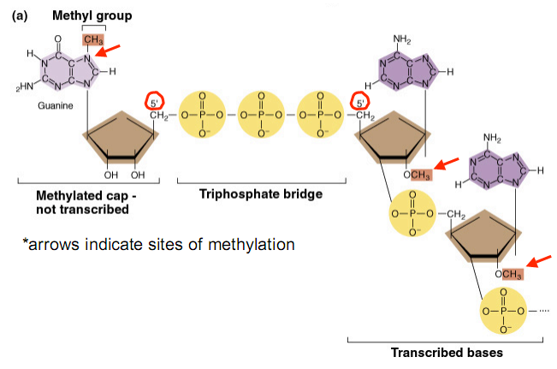
mRNA modifications

Slide 10
mRNA modifications
2. Addition of 100-200 Adenosines to the 3’ end, known as the poly-A tail.
NOT encoded by the gene.
First, ribonuclease cleaves the primary transcript to
form a new 3’ end (sequence AAUAAA is encoded 11 to
30 nucleotides upstream of the position where the tail is
added).
Then poly-A polymerase adds As onto this new 3’ end.
Thought to stabilize mRNA (prevent degradation) and
aid efficiency of translation

Slide 11
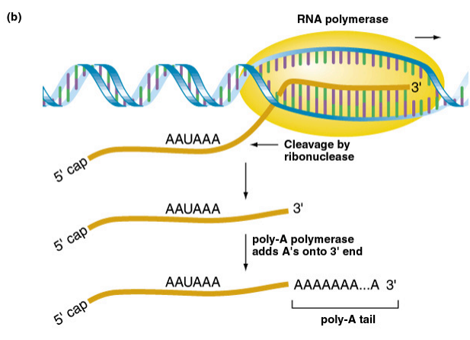
mRNA modifications

Slide 12
mRNA modifications
3. RNA splicing – removal of introns
Exons – sequences found in both a gene’s DNA and in the mature mRNA. Exons are coding sequences for the protein product
Introns – sequences found in a gene’s DNA but NOT in the mature mRNA. They are removed from the primary transcript.
Splicing is usually carried out by a complex
known as the spliceosome, although some
RNA transcripts are self-splicing

Slide 13
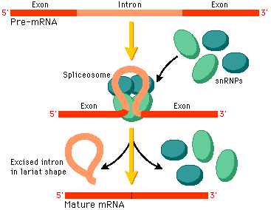
mRNA modifications
RNA splicing – removal of intron sequences
Exons – amino acid coding regions
They contain expressed sequences found in both a gene’s DNA and in the mature mRNA
Introns – non-amino acid coding regions
They contain intervening sequences found in a gene’s DNA but not in the mature mRNA

Slide 14
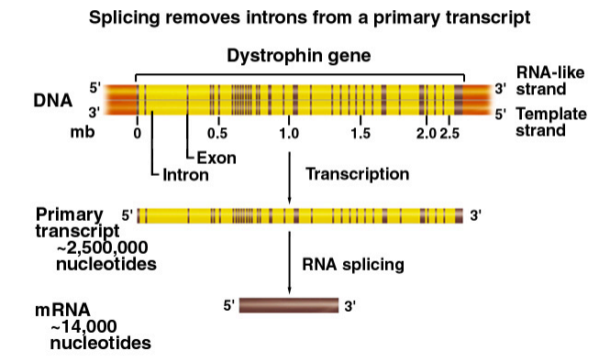
mRNA modifications

Slide 15
Why are introns present ?
Allow for alternative splicing : in some
cases, splicing may occur between the
splice donor site of one intron and the
acceptor site of a different intron
downstream.
Produces different mature
mRNA molecules that may encode related
proteins with different, though partially
overlapping amino acid sequences

Slide 16
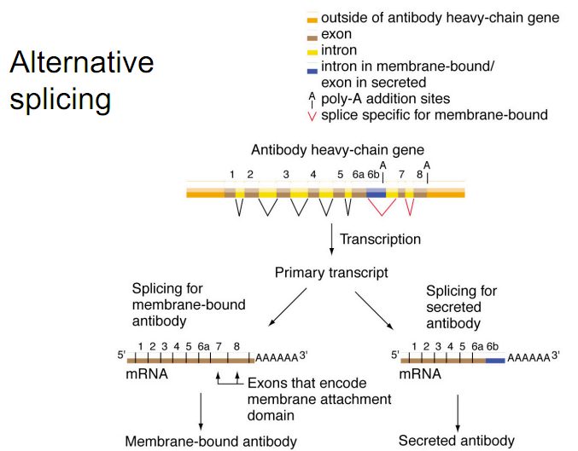

Slide 17
Why are introns present ?
Allow for trans-splicing : a form of
alternative splicing in which an exon
from one transcript can be joined to an
exon from a different transcript (from 2
genes)

Slide 19
Homework
Pg. 256 # 2-7, 9, 10

