Slide 1
Transfer of information from DNA
Chapter 6.1
McGraw-Hill Ryerson
Biology 12 (2011)

Slide 2
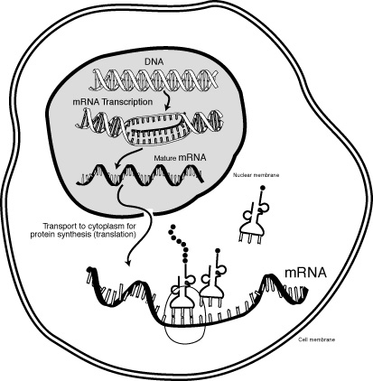
Link between genes and proteins
mRNA: RNA strand that serves information to be translated into protein
mRNA is synthesized (or transcribed) from DNA
Nucleotides from mRNA would provide the amino acid sequence for protein synthesis

Slide 3
The genetic code
Genetic code: code specifying relationship between nucleotide codon and an amino acid
How can 4 nucleotides encode 20 amino acids ?
Through groupings into triplets
4³ = 64
Each nucleotide triplet is known as a codon

Slide 4
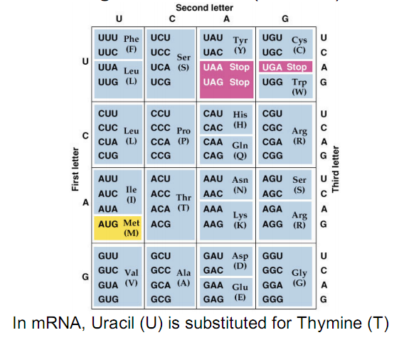
The genetic code

Slide 5
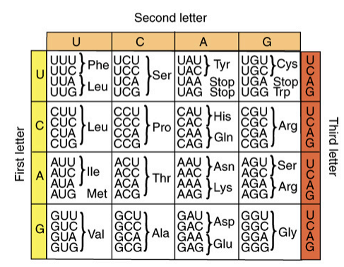
The genetic code
Genetic code has 3 characteristics
Code is redundant
more than one codon can code for the same amino acid or stop signal
Code is continuous
Reads as series of three-letter codons without spaces, punctuation, or overlap. Shifts of one or two nucleotides can alter codon triplets, resulting in incorrect amino acid sequence
Code is nearly universal
Almost all organisms build proteins with genetic code. Codon in fruity fly codes for same amino acid as in a human

Slide 6
The genetic code
AUG serves as the “Start” codon for growing polypeptides.
Can you locate it on this table? What amino acid is AUG?

Slide 7
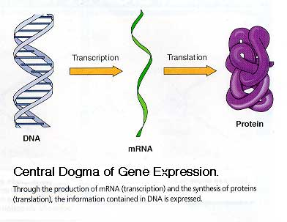
Gene expression
Central Dogma: theory that genetic information flows from DNA to RNA to protein
We will be discussing this more in the next section

Slide 8
Homework
Pg. 250 # 9-12, 14

