Slide 1
Systems

Slide 2
From micro to macro
Stem cells develop into specialized cells
Groups of the same specialized cells make up certain tissue
Collection of tissues can compose an organ
Multiple organs can work together to make up a system

Slide 3
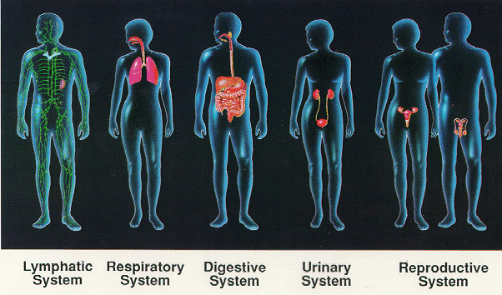
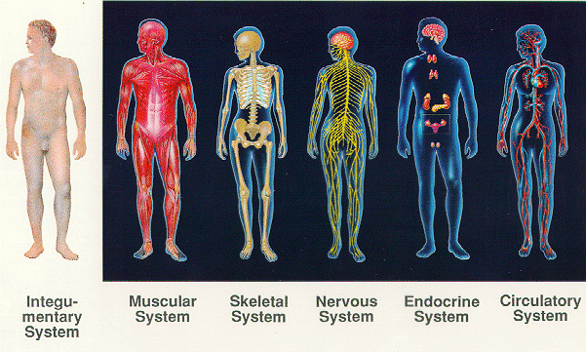
Ones we will discuss today:
Digestive system
Excretory system
Ones we will discuss next day:
Circulatory system
Respiratory system

Slide 4
Digestive System
Follow along the Magic school bus episode: “For Lunch” by using the time references on the left of each slide
Magic School Bus
Time References

Slide 5
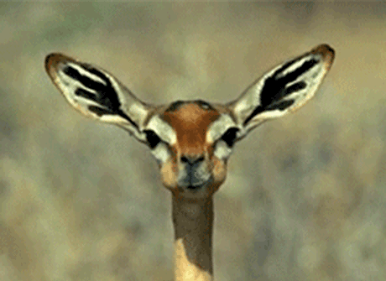
Mouth
Begins with “mastication” (chewing) in the mouth
Breaks food into smaller pieces
Allows amylase to chemically break down food
Amylase is an enzyme in saliva
Magic School Bus
Time reference
5:15-7:00

Slide 6
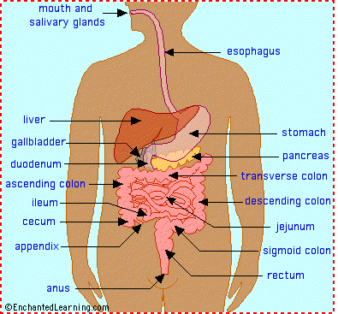
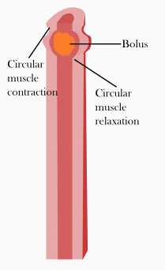
Esophagus
Food is swallowed
Passes through the pharynx
Enters the esophagus
Peristalsis moves food forward until it reaches the stomach
Peristalsis prevents food from being squeezed back into the mouth
Magic School Bus
Time Reference
7:15-8:15

Slide 7
Stomach
Stomach contains gastric juices secreted by epithelial tissue that lines stomach
Juices contain hydrochloric acid and enzymes
Acid serves 2 purposes:
Kills or inhibits bacterial growth
Pepsin (an enzyme) works best at low pH (acidic environment)
Stomach lined with mucus to protect wall from acid
Nerves in stomach sense food
Signals surrounding muscles to mix and mechanically break down food
Magic School Bus
Time Reference
8:15-12:00

Slide 8
Small Intestine
Sphincter relaxes to allow content into small intestine
Sphincter is a circular muscle
Pyloric (stomach) sphincter
Anal sphincter
Small Intestine divided into 3 sections:
Duodenum
Jejunum
Ileum
Magic School Bus
Time Reference
12:00 – 14:48

Slide 9
Small Intestine
Small Intestine divided into 3 sections:
Duodenum
Jejunum
Ileum
Duodenum
Contains ducts that connect to 3 organs:
Pancreas
Liver
Gall bladder
These organs release more enzymes in the duodenum to digest food
Villi & Microvilli
Small interior folds in walls of intestine
Absorbs nutrients in the bloodstream
Magic School Bus
Time Reference
12:00 – 14:48

Slide 10
Large Intestine
Large Intestine divided into 3 sections:
Colon
Rectum
Anus
Larger diameter but shorter length than small intestine
Contains bacteria
Bacteria breaks down food further
Provides essential nutrients (e.g. Vitamin K)
Functions:
Water absorption
Vitamin absorption
Salt absorption
Eliminate undigested food through anus as feces
Magic School Bus
Time Reference
14:48 – 17:00

Slide 11
Excretory System

Slide 12
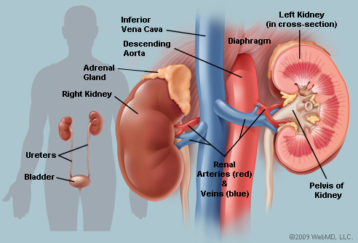
Kidneys & Bladder
Water, nutrients, and other materials are absorbed in walls of intestine and into blood stream
Blood passes through kidneys where it is filtered and remove
Inside the kidney is a network full of filters called nephron that filters the blood

Slide 13
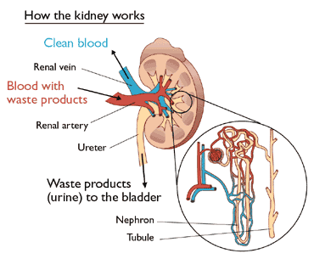

Slide 14
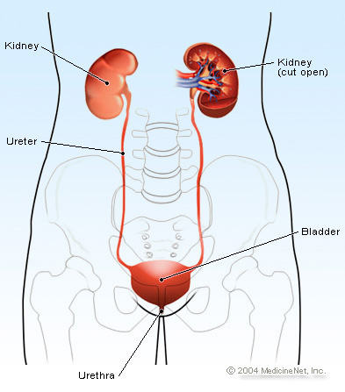
Kidneys & Bladder
Wastes end up in urine where it is stored in the bladder
When bladder is full, urine is excreted out of the body

Slide 15
Digestive vs Excretory system
Digestive system takes care of solid waste
Feces… … … … poop ☺
Excretory system takes care of liquid waste
Urine… … … … pee ☺

Slide 16
Homework
Pg. 107 #1, 2
Please have this along with the homework on pg 92 (#1, 2, 4, 5, 8) completed and ready to hand in on Friday (packaged and/or stapled)
Remember to write your name at the front
If you’re going to hand it in to me electronically, don’t copy the shortcut, Bethany

