Slide 1
Tissues
(Review)

Slide 2
Tissues
Tissues are made up of a group specialized cells
Specialized cells are made due to different factors:

Slide 3
Tissues
Tissues are made up of a group specialized cells
Specialized cells are made due to different factors:
Cytoplasm (uneven division)
Environment
Neighbouring cells
Genes

Slide 4
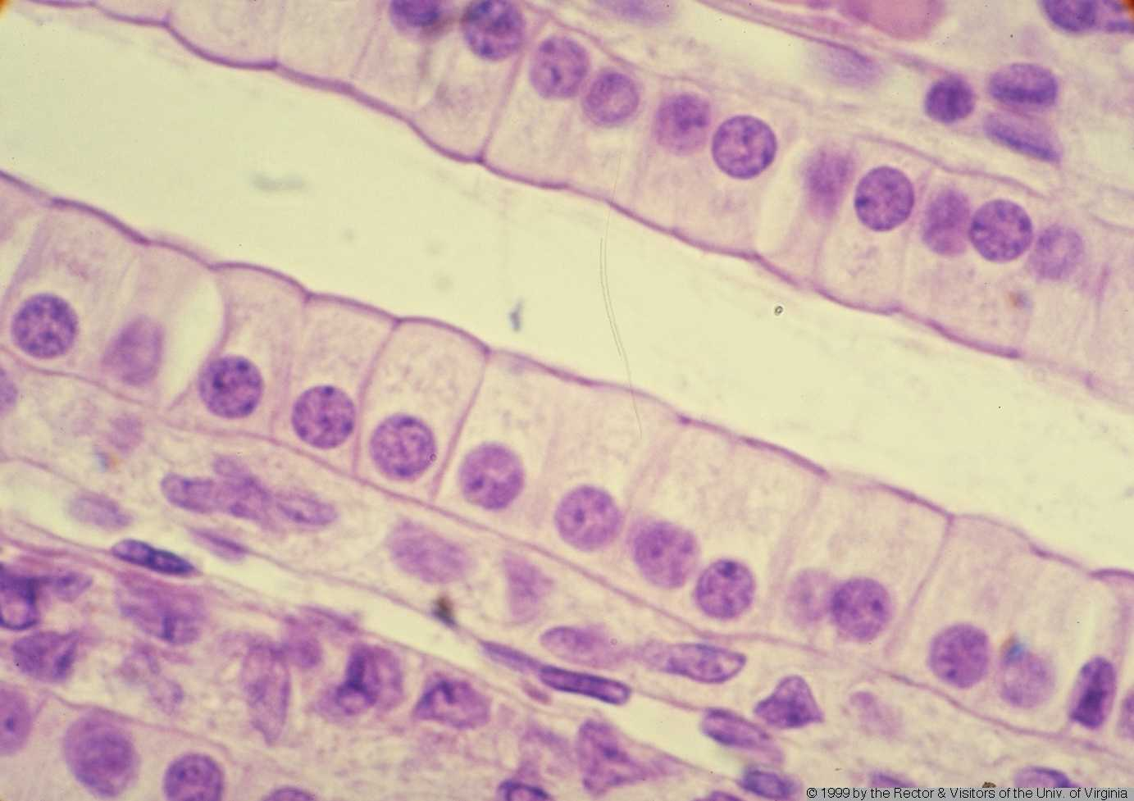
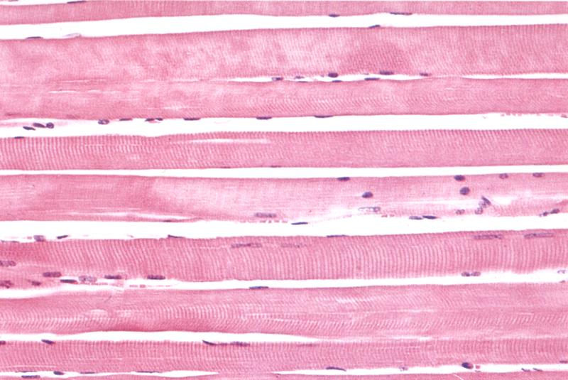
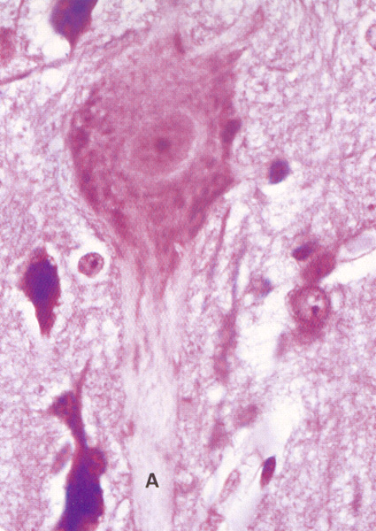
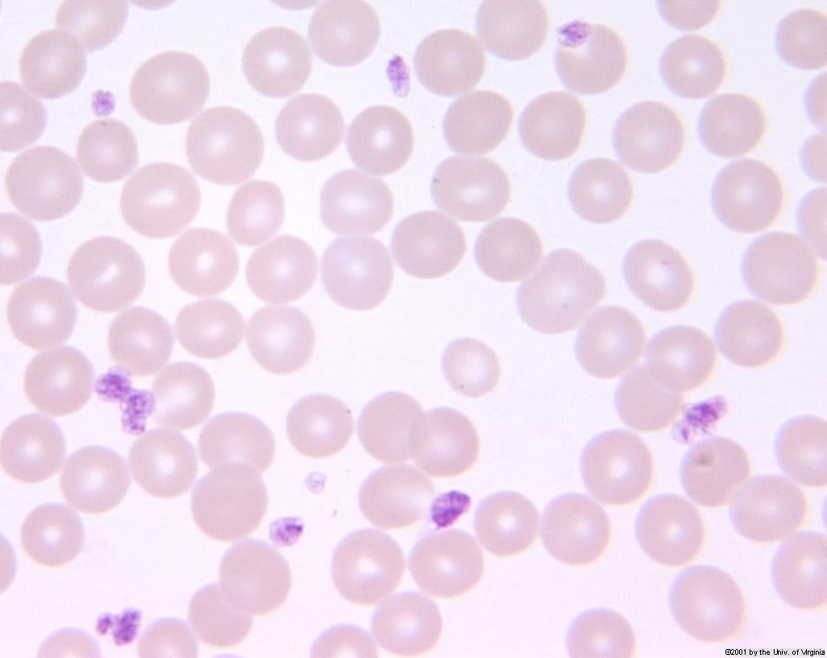
4 types of tissues

Slide 5
4 types of tissues
Epithelia
Muscle
Nervous
Connective

Slide 6
Where does it start?
Tissues are made of specialized cells
Specialized cells arise due to different factors
But arise from what?
How does it all start?

Slide 7
Stem Cells

Slide 8
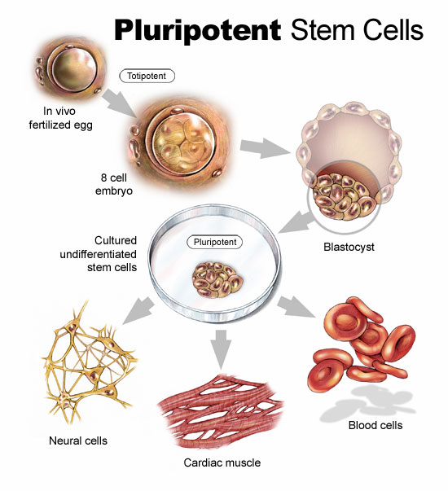
Stem cells
Stem cells are unspecialized cells that can produce various specialized cells
2 types
Totipotent: Able to become any kind of cell in the body (more versatile)
Pluripotent: Able to produce many kinds of cells in the body but not all (less versatile)

Slide 10
Medical Potential of Stem Cells
Due to stem cells being able to produce various types of cells they can be used to replace lost/damaged/destroyed cells
E.g. Bone Marrow is responsible for producing blood cells.
E.g. Embryonic stem cells used to regenerate lost or damaged tissue

Slide 11
Ethics behind Stem Cells
2 categories of stem cells
Adult stem cell
Cannot differentiate thus must extract same type of stem cell to the one patient is needing
Extracted using non-lethal surgical techniques
Embryonic stem cell
Can differentiate into over 200 types of different cells thus can harvest a lot to serve many purposes
Extracted from an embryo which leads to death of embryo

Slide 12
Ethics Discussion
Do you think it’s right to harvest stem cells?
Think about the types of stem cells
Think about the source of those stem cells
Why or why not?

Slide 13
Discussion on Cloning
What do you know about cloning?
What movies have you seen that involve cloning?
Star Wars Prequels
The 6th Day
Multiplicity
Austin Powers (mini-me)
The Fifth Element
Etc.
How are clones made?

Slide 14
How a clone actually gets made
Page 25 of your textbook illustrates it beautifully

Slide 15
Preview for next class
In groups, use the chart paper and draw out the digestive system
Label the organs
Add descriptions of what each part of the digestive system does
Write anything else you know about the digestive system

Slide 16
Homework
Pg 92 #4, 5, 8
If you can, write on the same piece of paper as the last homework. I’ll be collecting the homework for this chapter altogether at the end of the week.

