Slide 1
Cells & Tissues

Slide 2
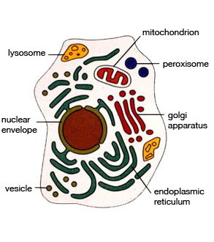
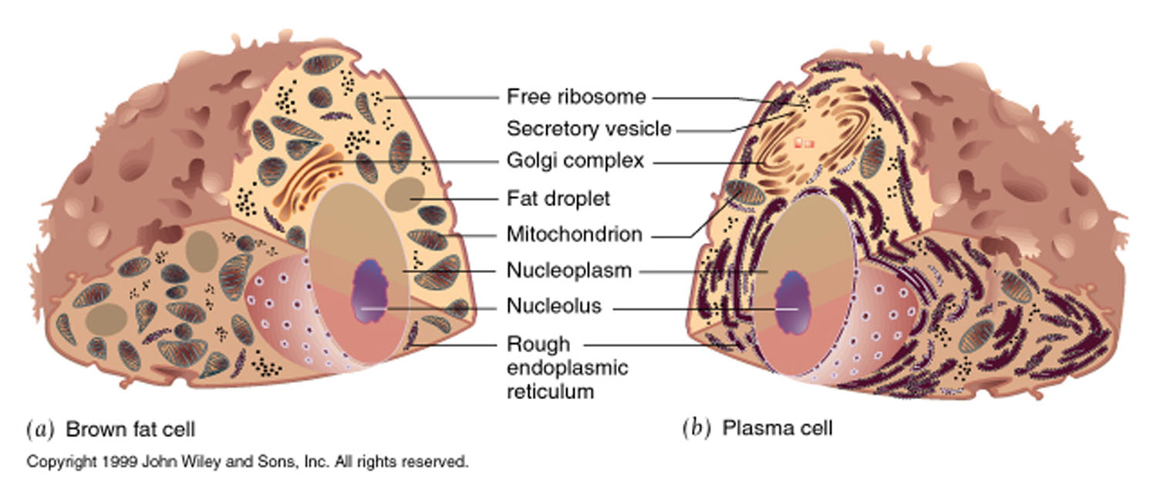
Elements-diversity
Cell structure predicts function
-cells contain the same elements
-organelle amplification gives function

Slide 3
Factors that influence cell specialization in animals
Cytoplasm
Environment
Neighbouring cells
Genes

Slide 4
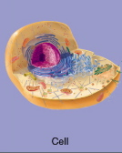
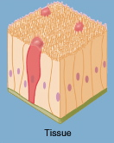
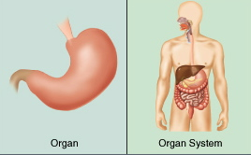
Elements-diversity
Cell structure predicts function
cells live in communities =TISSUES
4 types of tissues
Tissues:
Epithelia
Connective Tissue
Muscle
Nerve

Slide 5
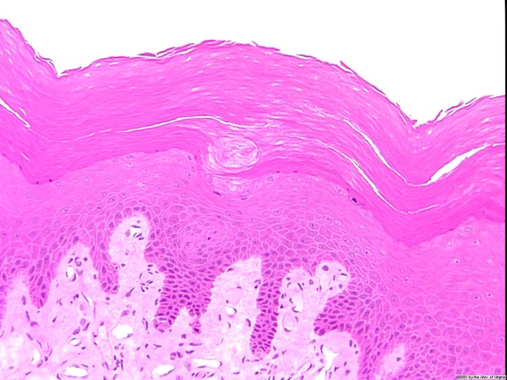
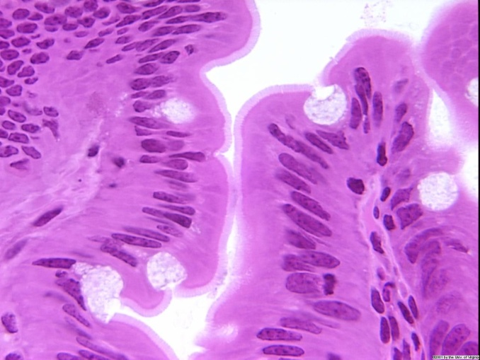
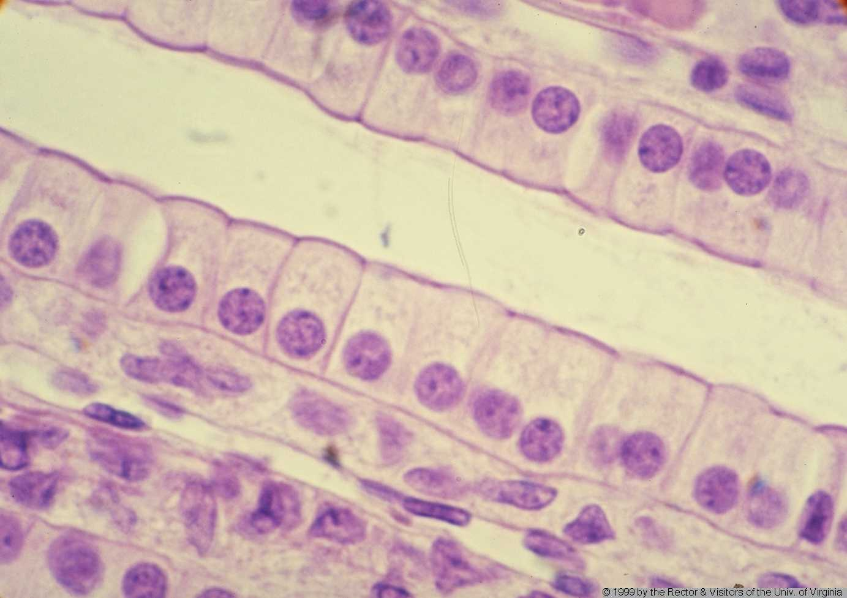
Epithelia-functions
Epithelial Functions
protection
absorption
secretion
transport
barrier

Slide 6
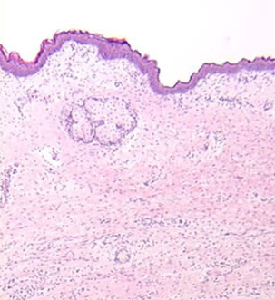

Slide 7
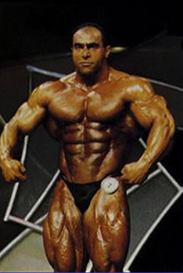
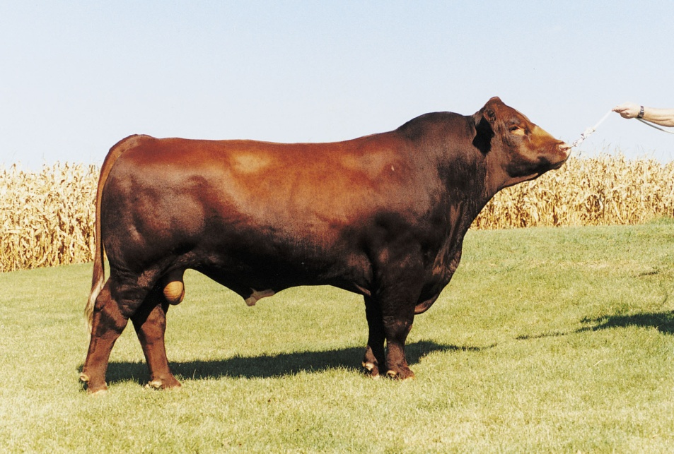
Muscle Tissue-functions
Muscle Tissue Functions
Contraction (force generation)
-movement
-structural support
-glands
-physiology
Notes:
Muscular movements contract veins, make blood flow

Slide 8
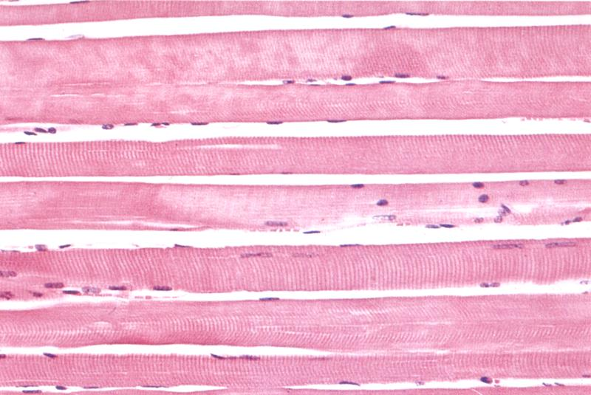
Muscle Tissue-types-skeletal
Skeletal Muscle
-muscle fibers (cells)
-long cells (35 cm)
-multinucleate
-in longitudinal section
-long
-striated
-peripheral nuclei
-unbranched
Notes:
Top cross section, bottom longitudinal section
Nuclei lie in periphery
Space is due to shrinkage (no real space)
C = capillary P = perimysium

Slide 9
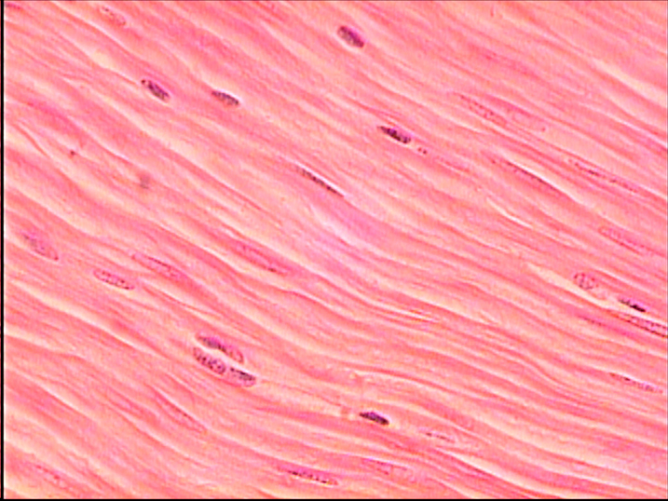
Muscle Tissue-types-smooth muscle
Smooth muscle
-unstriated
-central nucleus
-appears smooth
-central elongate nucleus
-concentric layers
-can be very thick
-extended contraction
-digestive system
-blood vessels
-uterus
Notes:
Very thin, very elongate
Not directional, cells just get smaller

Slide 10
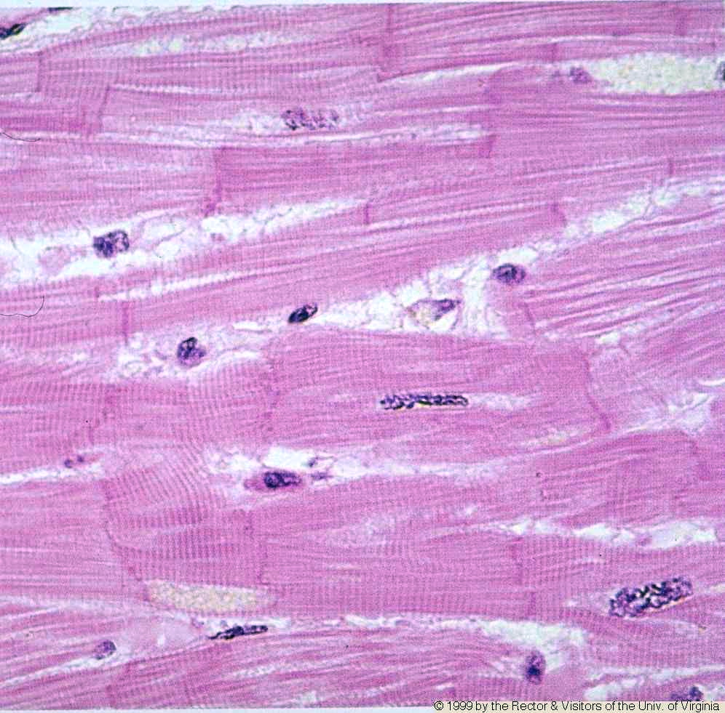
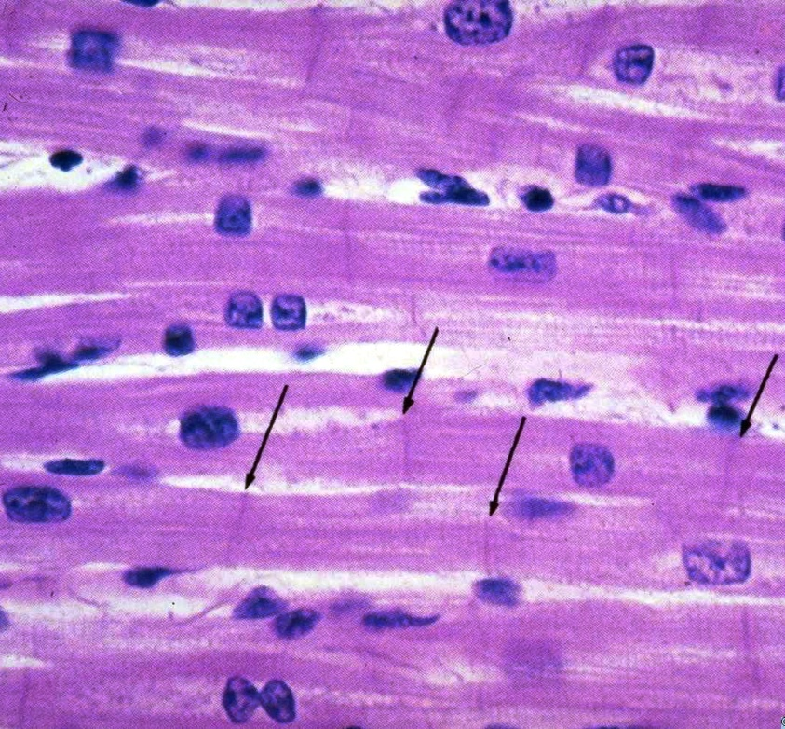
Muscle Tissue-types-cardiac muscle
Cardiac Muscle
-striated muscle
-branched fibers
-1-2 nuclei/cell (square/central)
-intercalated disks
-highly vascularized
Notes:
Looks interwoven (branched)
White space in right pic actually mitochondria, arrows point to intercalated disk
Left pic, see a lot of capillaries

Slide 11
Myotonia Congenita

Slide 12
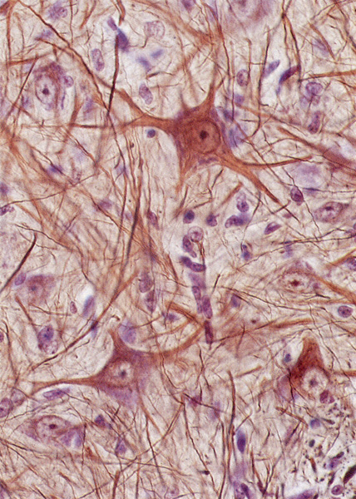
Nerve Tissue-functions
Nervous Tissue Functions
communication (signal conduction)
-inter-cellular chemical
-intra-cellular electrical
-arranged in networks
-sensory
-motor
Notes:
Whiskers are sensory
Slice of brain has mirror image of whiskers (mid bot)
Intracellular = electrical

Slide 13
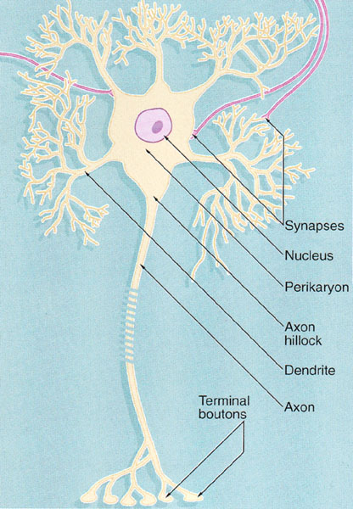
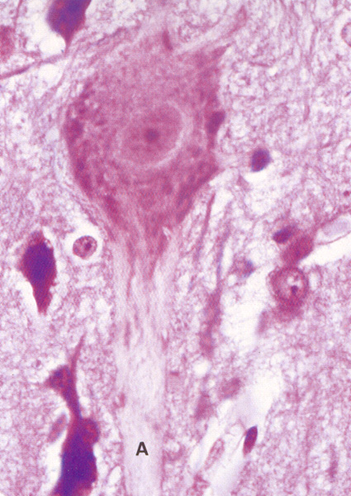
Nerve Tissue-neurons
Neurons
-size, shape highly variable, asymmetric
-dendrites = input (afferent)
-axon = output (nerve fiber) (efferent)
-cell bodies found in nervous tissue
Notes:
Left pic = nucleus on bottom, tree structure is dendrite (inputs), 1 axon output on the other end
Some ganglia found in digestive system
Axon short in brain, long in PNS

Slide 14
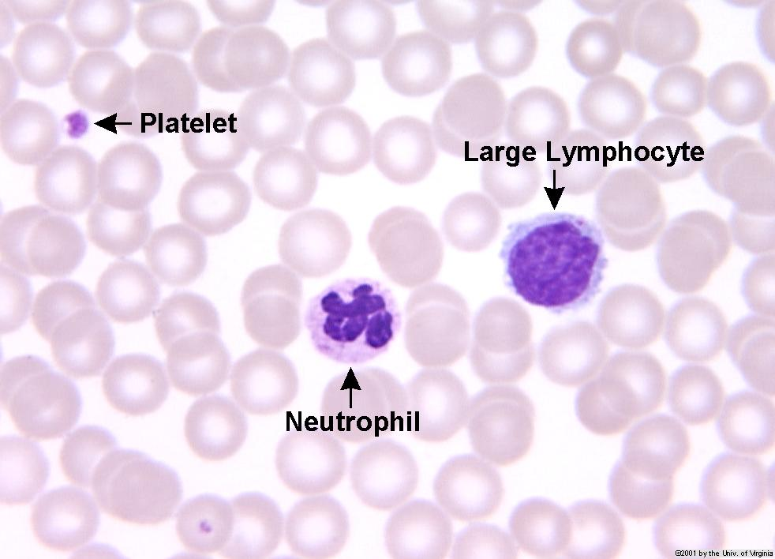
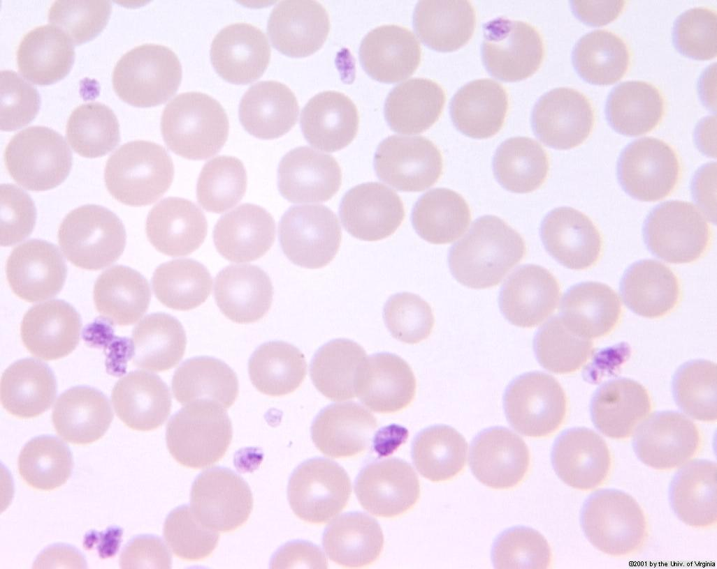
Blood Functions
- transport
-gases (O₂, CO₂)
-nutrients
-cells (leukocytes)
-hormones
- wound healing
-clot formation
-remodeling (scar)

Slide 15
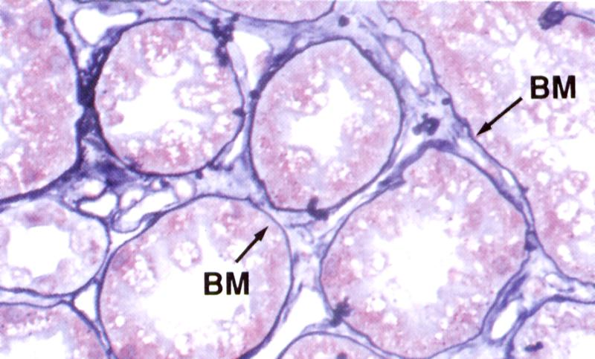
Connective Tissue-functions
Connective Tissue Functions
Maintain boundaries
Structural support
Cell adhesion and movement
Protection
Molecular exchange
Notes:
-forms basement membrane of epithelium
Bone, fat, -> connective tissues, cartilage

Slide 16
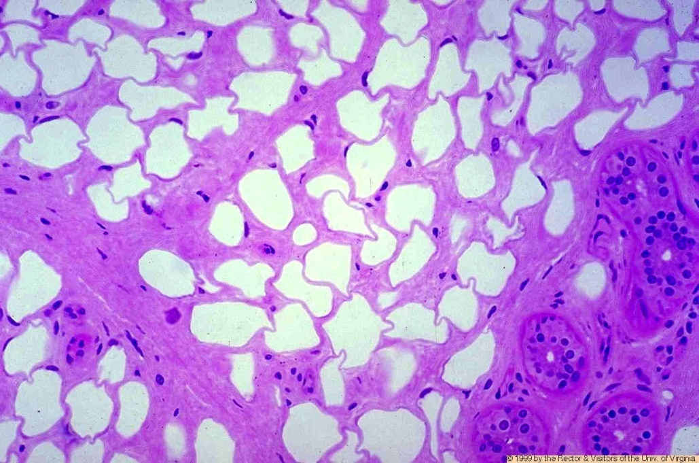
Connective Tissue-types
Adipose connective tissue
-each cell single fat vacuole
-white fat
-fat fat
-energy storage
Notes:
Slide missing right before this
Dense regular connective tissue
-arteries
Will see brown fat and white fat together

Slide 17
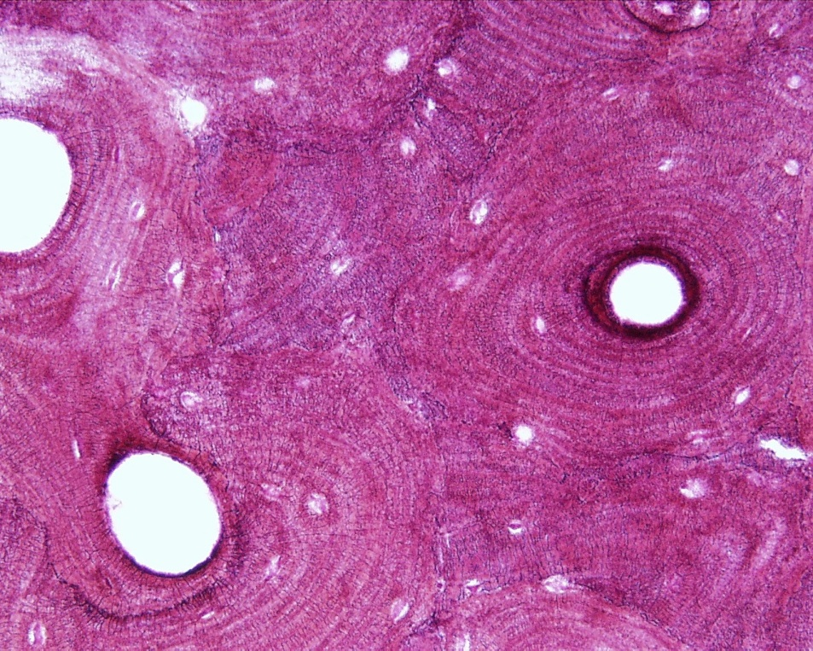
Skeletal system-bone structure
Bone
Notes:
Lamellae clearly visible as tree trunk shape
Most of what we see is secondary bone

