Slide 1
Chemistry in Living Systems A very basic overview
Chapter 1.1
McGraw-Hill Ryerson
Biology 12 (2011)

Slide 2
A lot of lingo
These words are terms you’re going to encounter throughout the course. We will take the time today to know them.
Isotope | Radioisotope | Molecule | Organic molecule
Biochemistry | Intramolecular | Intermolecular | Hydrogen bond
Hydrophobic | Hydrophilic | Ion | Functional group

Slide 3
Intramolecular forces
Covalent bonds form between two non-metal atoms
Electronegativity
Causes electrons to be more attracted to an atom
Causes partial charges
Polarity
Partial charges causes unequal sharing leading to polarity

Slide 4
Intermolecular forces
Hydrogen bond
Polar interactions
Hydrophillic interactions
Hydrophobic Interactions
Non-polar interactions

Slide 5
Ion
2 types:
Cation
Anion

Slide 6
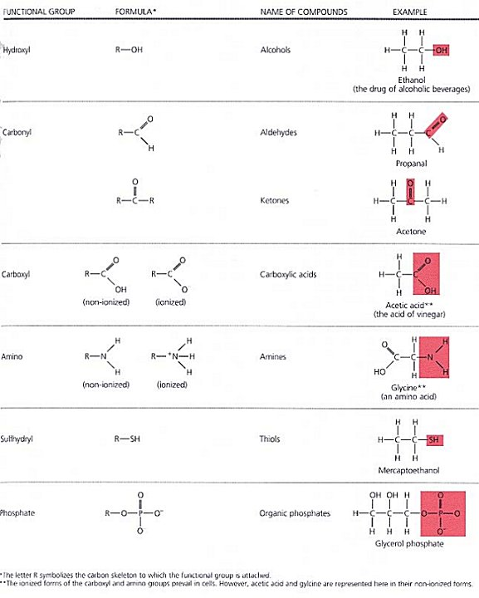
Functional Groups
Hydroxyl
Carbonyl
Carboxyl
Amino
Sulfhydryl
Phosphate

Slide 8
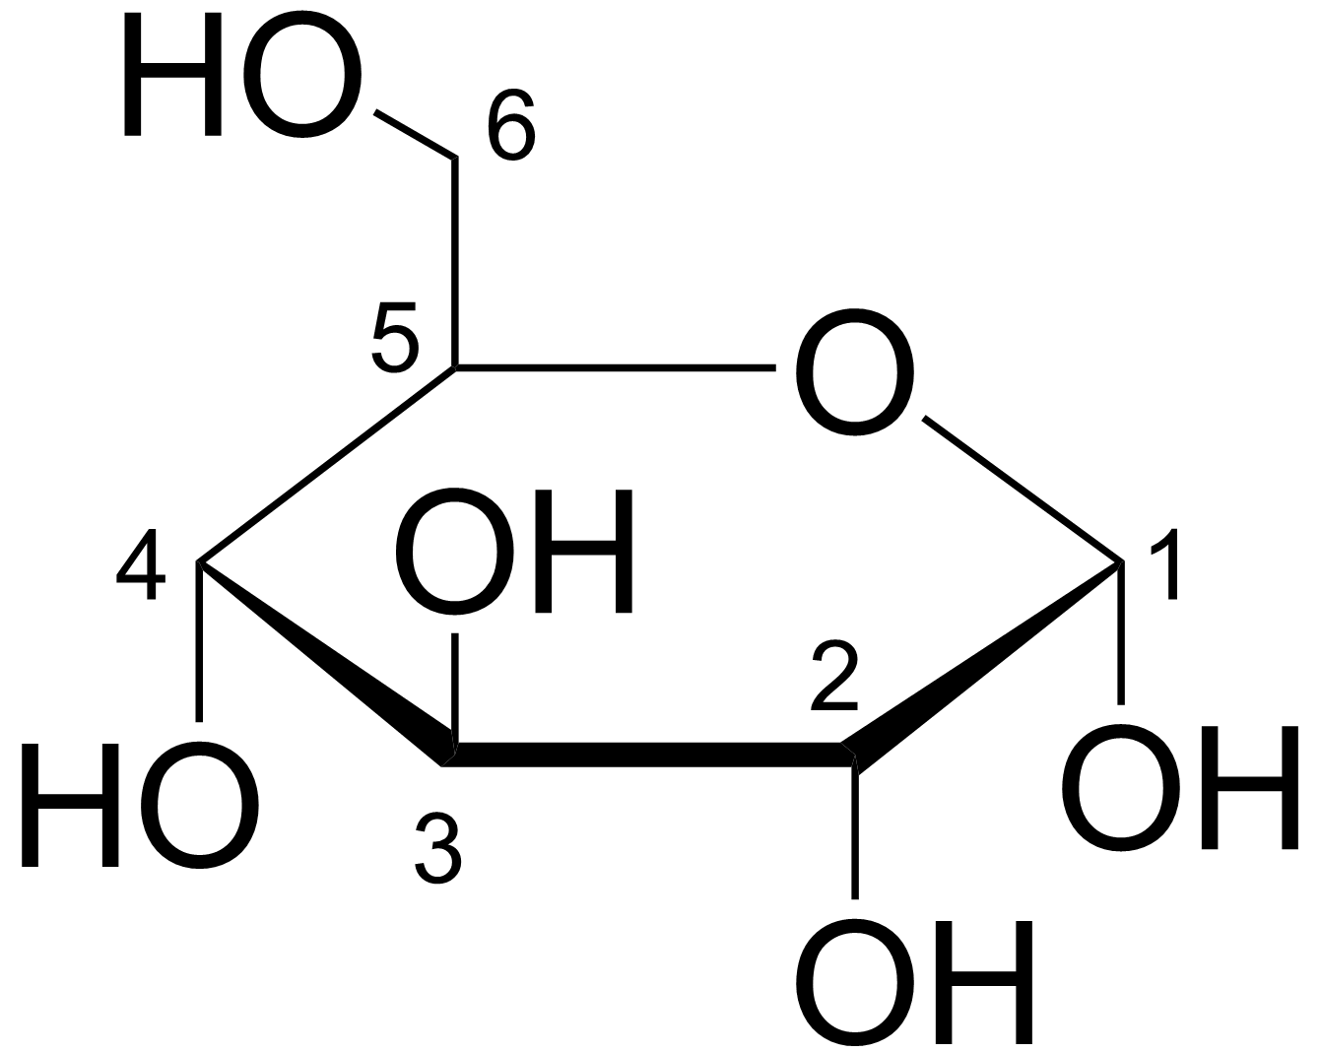
Structures and Shapes
Know how to draw shapes from molecular formulas
Be able to recognize compounds from structures and drawings

Slide 9
Homework
Pg 17
#3, 4, 5, 9, 11

